Slide 1
Super scattering in CMP system
Yutong Zhao & Jinwei Rao
Jun 8th 2019

Slide 2
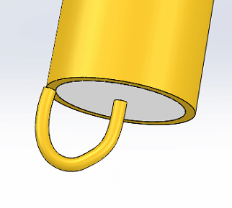
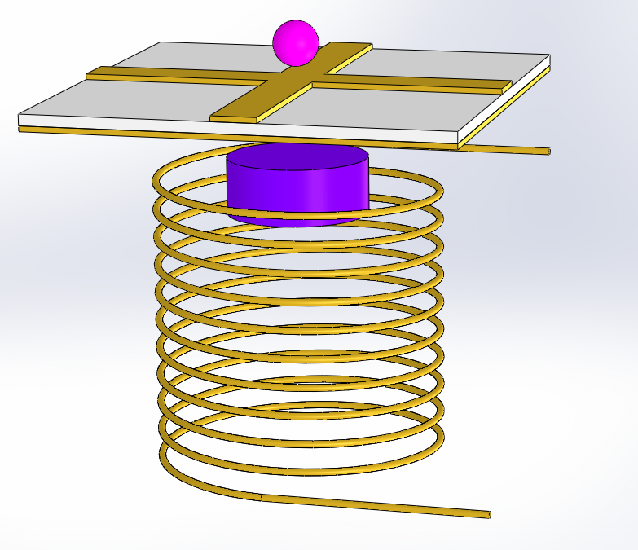
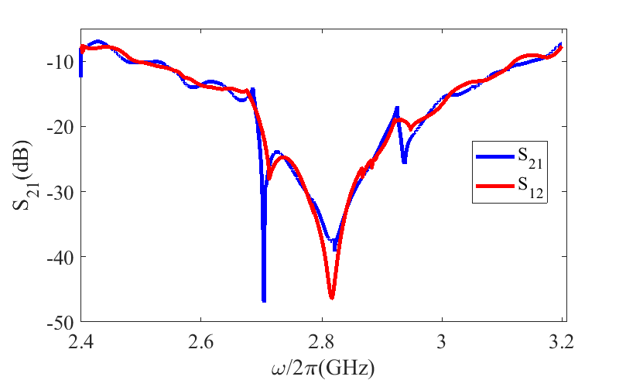

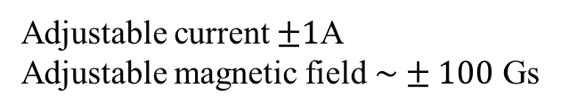
Experiment setup
Port can be switched to detect S₂₁ or S₁₂
When measure S₂₁ or S₁₂, probe was disconnected.
When measure field distribution, the output port was connected to a 50 Ohm terminator.
3D stage
H field probe
$$ΔH≈1 mm$$
Signal
Generator
YIG
Transmission
Signal
Analyzer
Magnet
V
Adjustable current $±1$A
Adjustable magnetic field $\sim ±100$ Gs

Slide 3
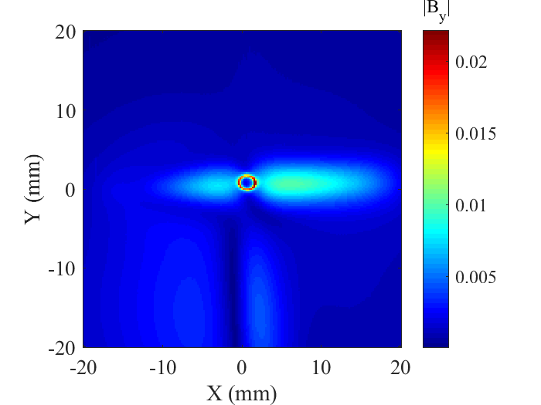
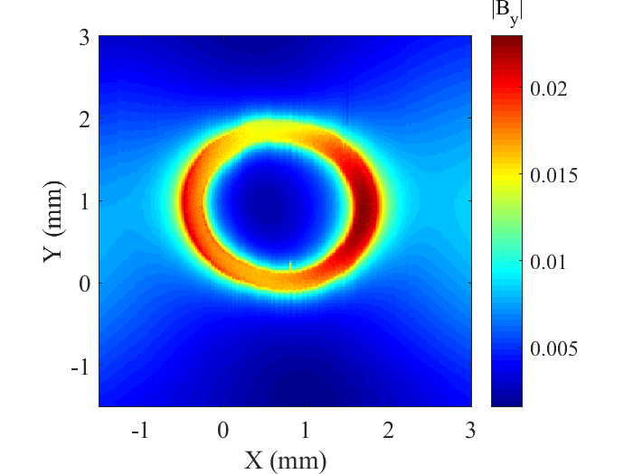
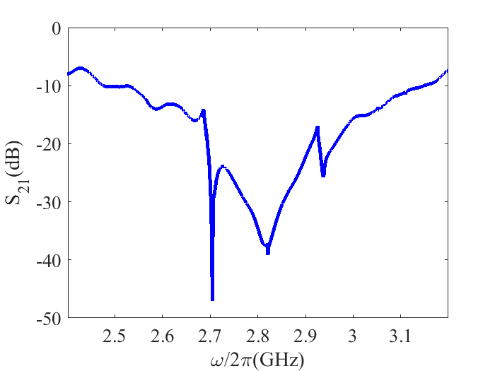
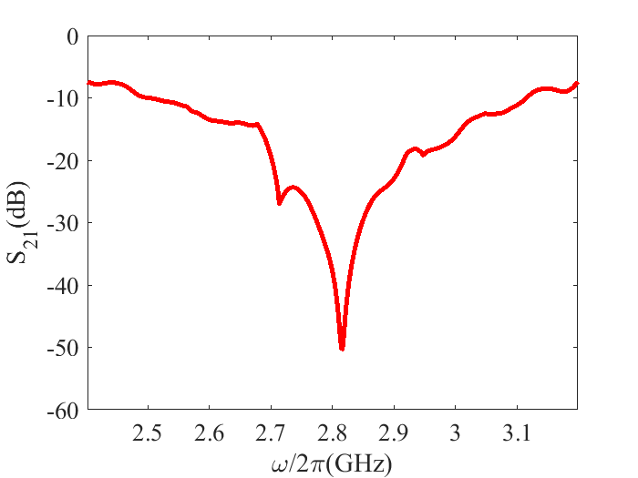
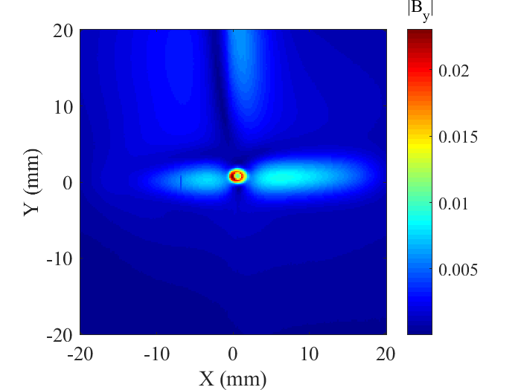
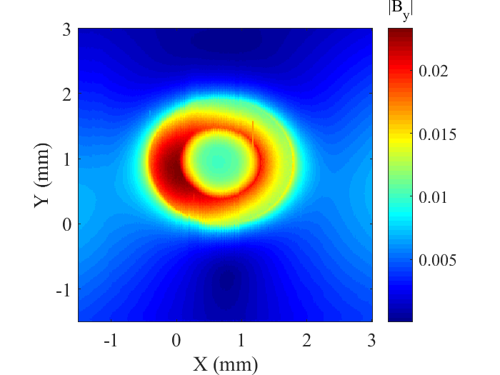
S₂₁
S₁₂

Slide 4
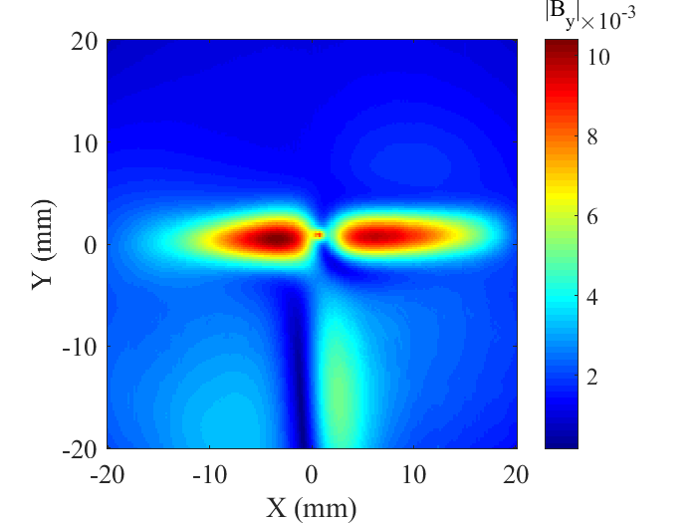
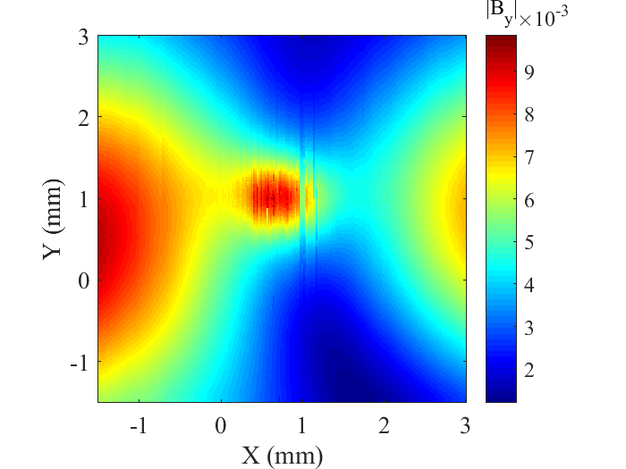
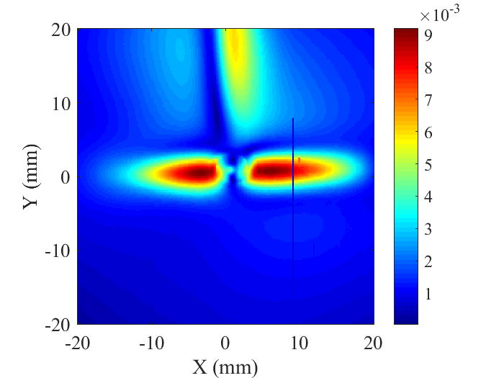
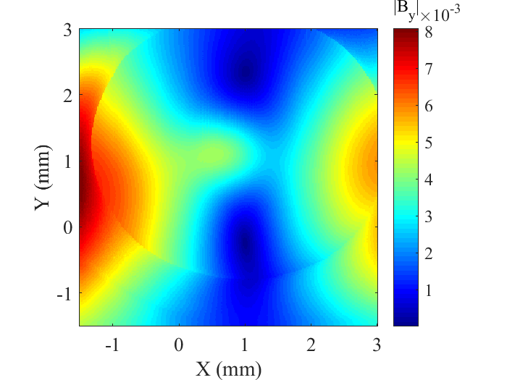

Slide 5
Next step

